Slide 1
Additional Materials

Slide 2
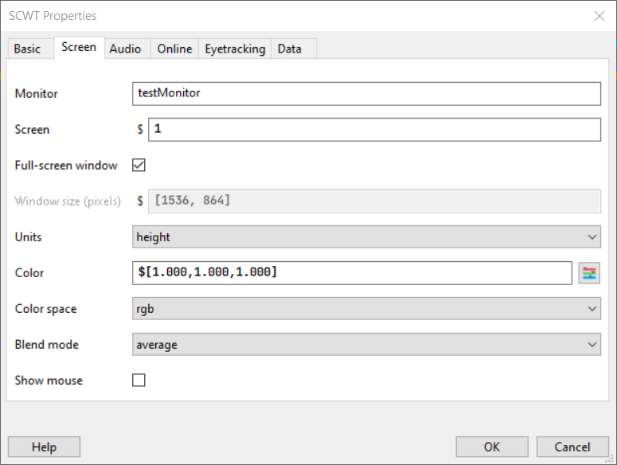
Changing the Color of the Screen
Select “Edit Experiment Settings”
Under the “Screen” tab, edit the “Color” properties to adjust screen color

Slide 4


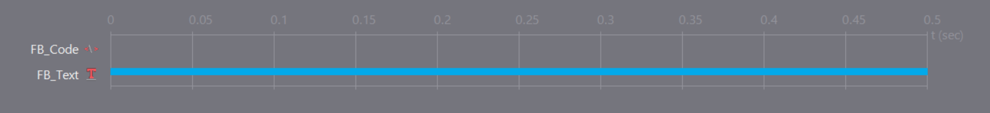
Feedback Loops
Minimal coding knowledge required
First, add a Code and Text component to a Routine. It should look something like this
Duration of FB_Text determines how long you want your feedback text to be displayed

Slide 5
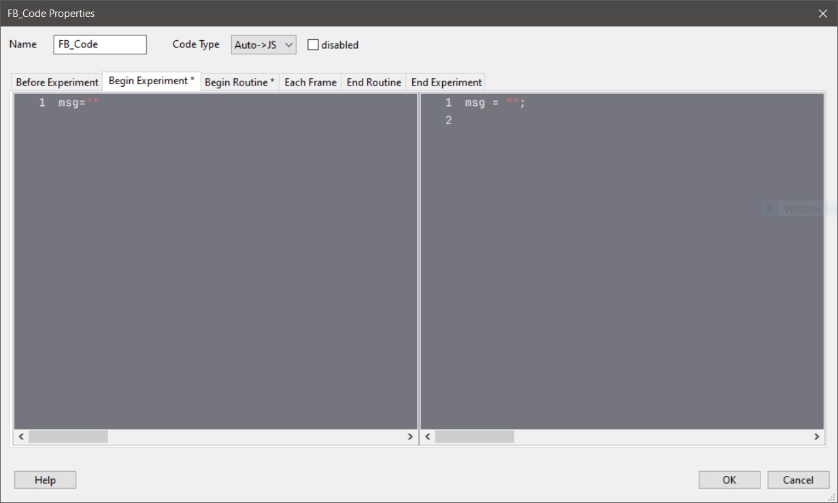
Feedback Loops – FB_Code
Under “Begin Experiment” tab, you want to create a blank object called “msg”
msg = “”
This allows us to define the message depending on the performance of the participant

Slide 6
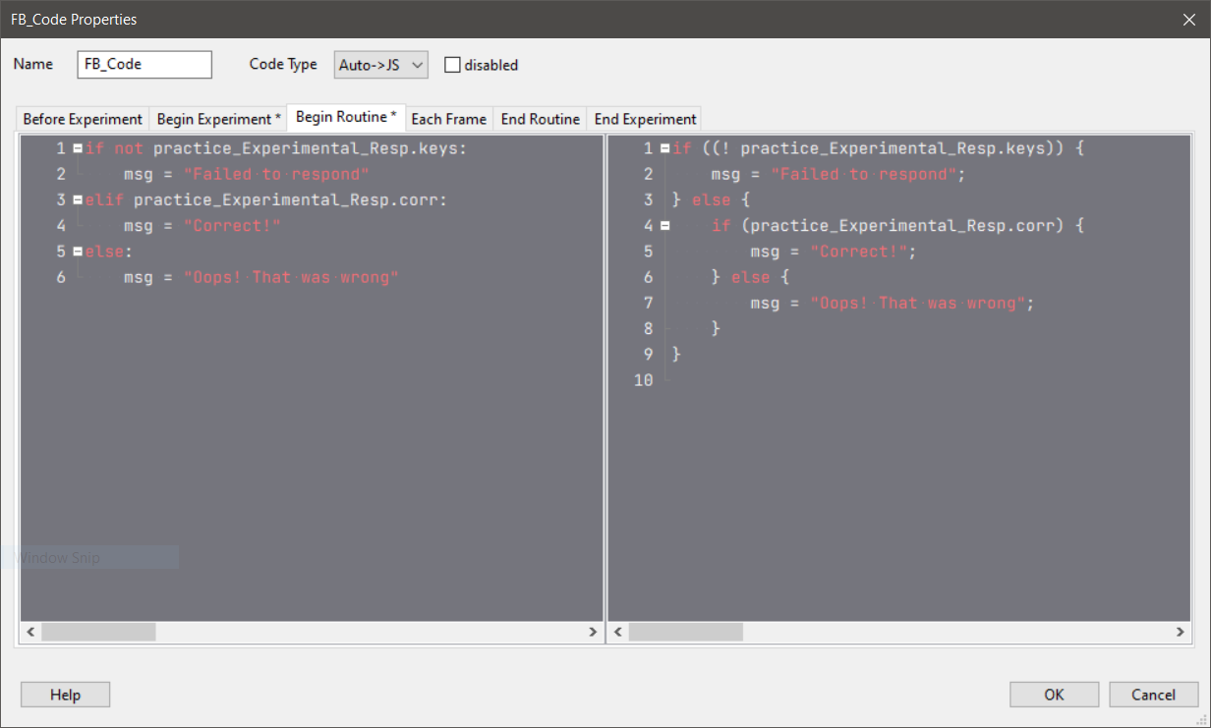
Feedback Loops – FB_Code
Under “Begin Routine” tab, you now define what the msg object contains using a simple if-else statement

Slide 7
Feedback Loops – FB_Code
if not practice_Experimental_Resp.keys:
msg = "Failed to respond"
elif practice_Experimental_Resp.corr:
msg = "Correct!"
else:
msg = "Oops! That was wrong"
If participants did NOT press any of the response keys, the msg object will now contain “Failed to respond”
If participants pressed the correct response key, the msg object will now contain “Correct!”
If participants pressed the wrong response key, the msg object will now contain “Correct!”

Slide 8
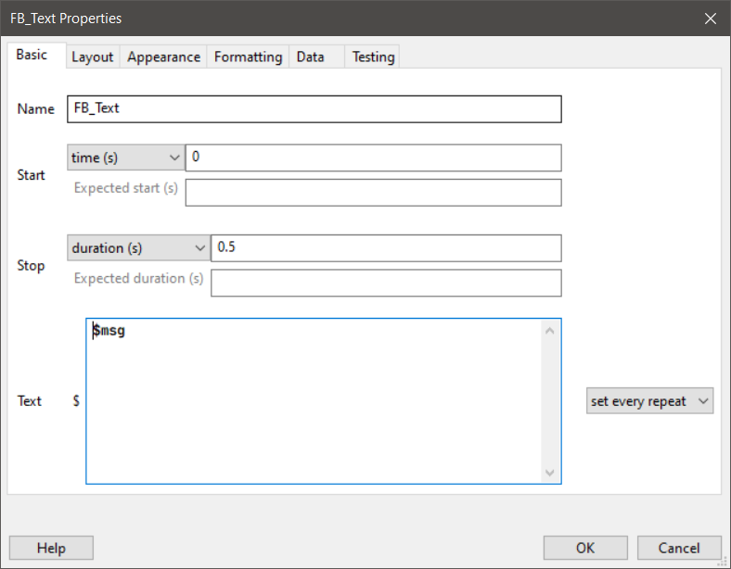
Feedback Loops – FB_Text
Now, we need to tell the Text component to display the msg object that we coded using “$”
Ensure that you set this to “set every repeat” so that the component refreshes every loop
Lastly, we need to add FB_Text into our Flow

Slide 9
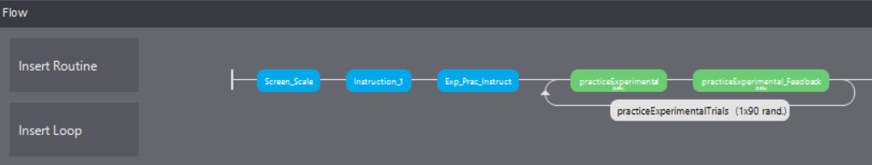
Feedback Loops
Click on “Insert Routine” and insert your Feedback Loop Routine AFTER your trial Routine
Every time a response key is pressed during a trial, that information will be transferred to the Feedback Loop Routine, and a message will be displayed indicating if the response was correct or incorrect

Slide 10
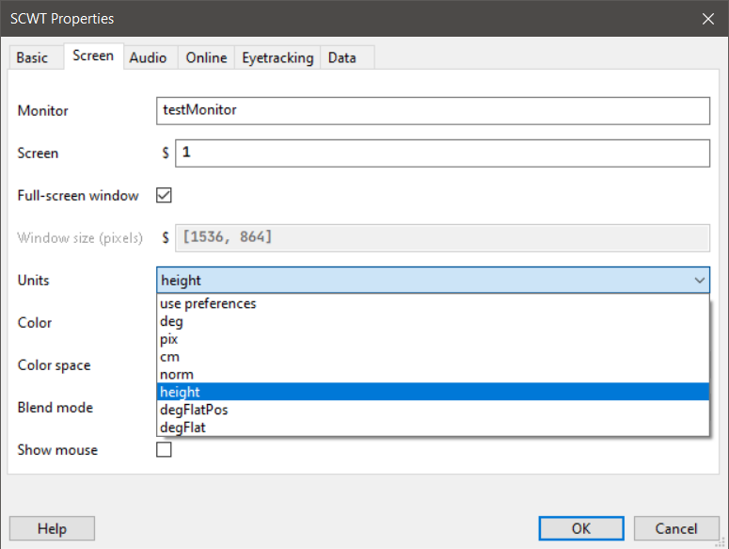
Units and Scaling
An important factor to consider when running online experiments is the standardization of stimuli size across participants who will likely be using different monitors
To do so, we need to know a bit about the types of units in PsychoPy:

Slide 11
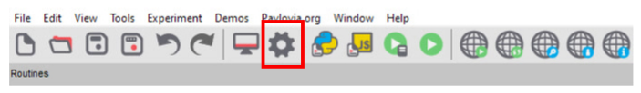

Slide 12
Units and Scaling
Height
Everything is specified relative to the height of the window (note the window, not the screen)
Norm
Everything is specified relative to the X, Y dimensions of the window (note the window, not the screen)
Cm
Set the size and location of the stimulus in centimeters on the screen, can be verified by “drawing” a stimulus and measuring the dimensions to check that its indeed a square

Slide 13
Units and Scaling
Deg/DegFlat/DegFlatPos
Use degrees of visual angle to set the size and location of the stimulus. Dependent on the distance that the participant sits from the screen as well as the screen itself
Pix
Specify the size and location of your stimulus in pixels, Dependent on the pixel size of monitor
We recommend sticking to Height and Norm units if your experiment is not too concerned with stimulus size
If stimulus size needs to be kept constant, then using Cm, Deg, Pix units is recommended as those do not scale with window size

Slide 14
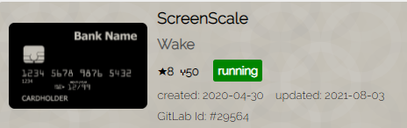
Units and Scaling
Typically, we can standardize stimuli according to participants’ window dimension by getting participants to compare a common real-world object with a standardized size on the screen (i.e. credit cards)
This allows the experiment to obtain the dimensions of the screen relative to each participant, and you can then use that information to scale your stimuli accordingly
TIP: You can find many experimental templates like this on Pavlovia

Slide 15
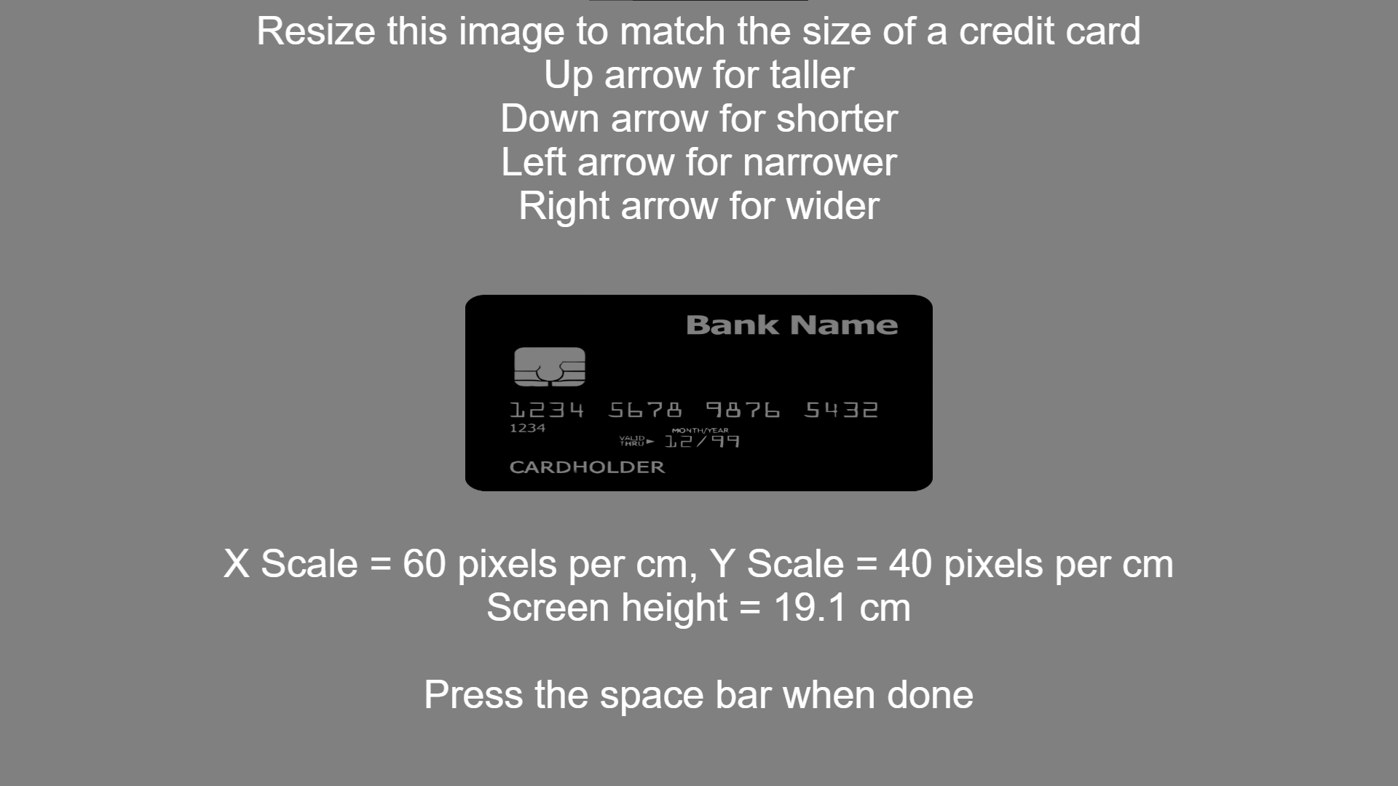

Slide 16
Data Analysis
Running experiments offline would store participants data locally on your hard drive. Using Pavlovia, participants data are stored in the cloud
Data for each participant would be stored in an .csv file. If you have 50 participants, you will have 50 .csv files
Usually, you would need to use some coding software (e.g. Python, R) to clean your data and aggregate them
For the purposes of this workshop, we will not go over how to clean/aggregate your data, rather, we will explore the kinds of raw data you can obtain

Slide 17
Data Analysis
At this stage, if your naming of your routines/components are not consistent or clear, you may have a very rough time understanding what’s going on. Particularly if you are collaborating with others, its very crucial to have simple naming rules.
In your data file, there are some keywords that can help you identify the type of data being stored:
.thisRepN/TrialN/N/Index | Counts how many stimuli/trials have passed
.start/stopped | Counts the seconds when a stimulus is presented/stopped
.keys | Logs the key press by the participants
.rt | Logs the reaction time (seconds) taken to press a valid key(s)
.corr | Logs the accuracy (1 = correct, 0 = wrong)

Slide 18
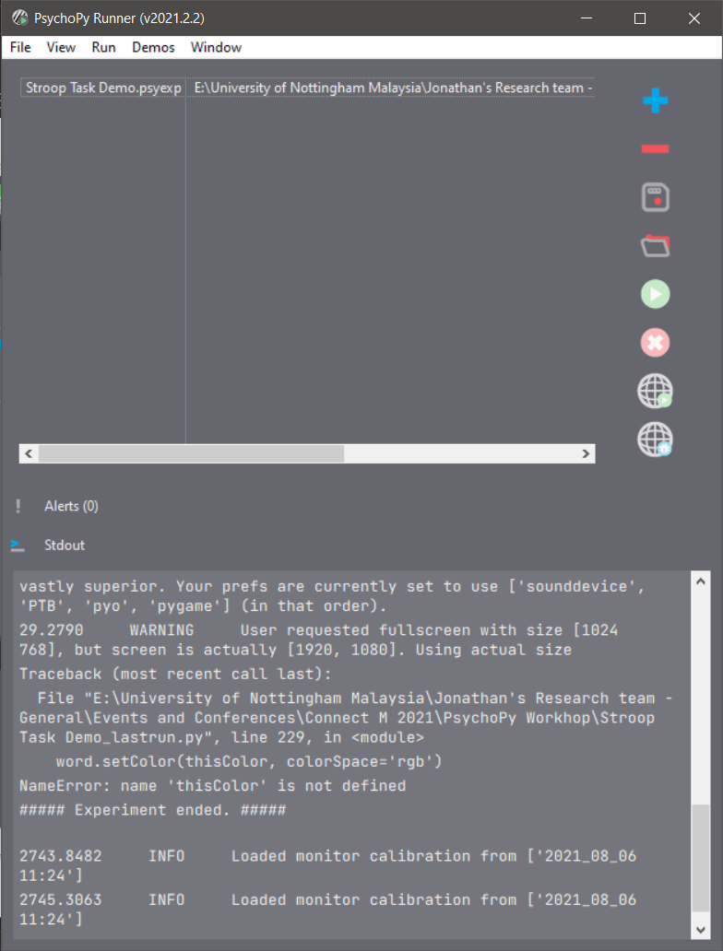
Troubleshooting
The Runner is your best friend here! Errors will be logged here, and you can usually identify the problem from the last couple of lines that caused the experiment to crash
For example, this experiment crashed because my Stroop color stimulus was not defined. This means that one of the components may not have been set up properly

Slide 19
Troubleshooting
If you’re not sure what the error means, you can always copy paste the error into Google ending with “psychopy”
Results would often point you to https://discourse.psychopy.org, where you can find resources to assist you in debugging

Slide 20
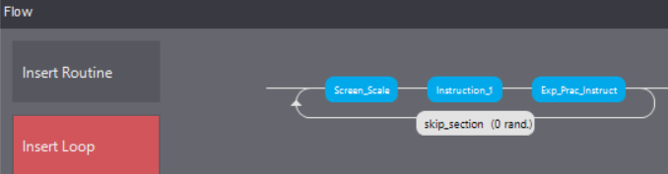
Troubleshooting
Its handy to know how to skip portions of your experiment. If you have a 15-minute experiment, you don’t want to sit through the whole experiment just to troubleshoot one specific block
To do this, insert an empty loop between the sections that you want to skip and set nReps to 0

Slide 21
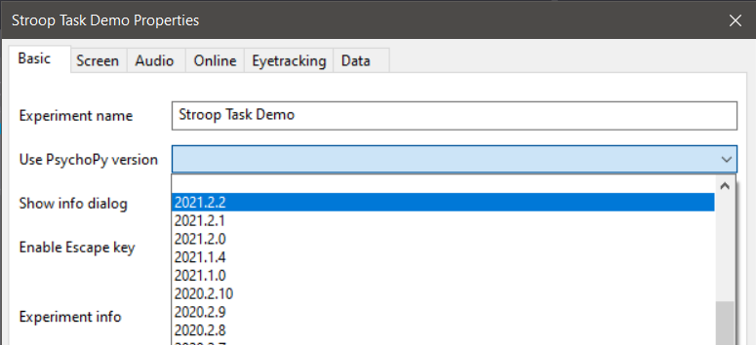
Important Reminders
Do not touch the Coder unless you know what you are doing, it’s a one-way street! Once a code is changed in the Coder, you can no longer use the Builder!
If you’ve updated your PsychoPy, but your experiments were coded in a previous version, you may want to force PsychoPy to use an older version

